Slide 1


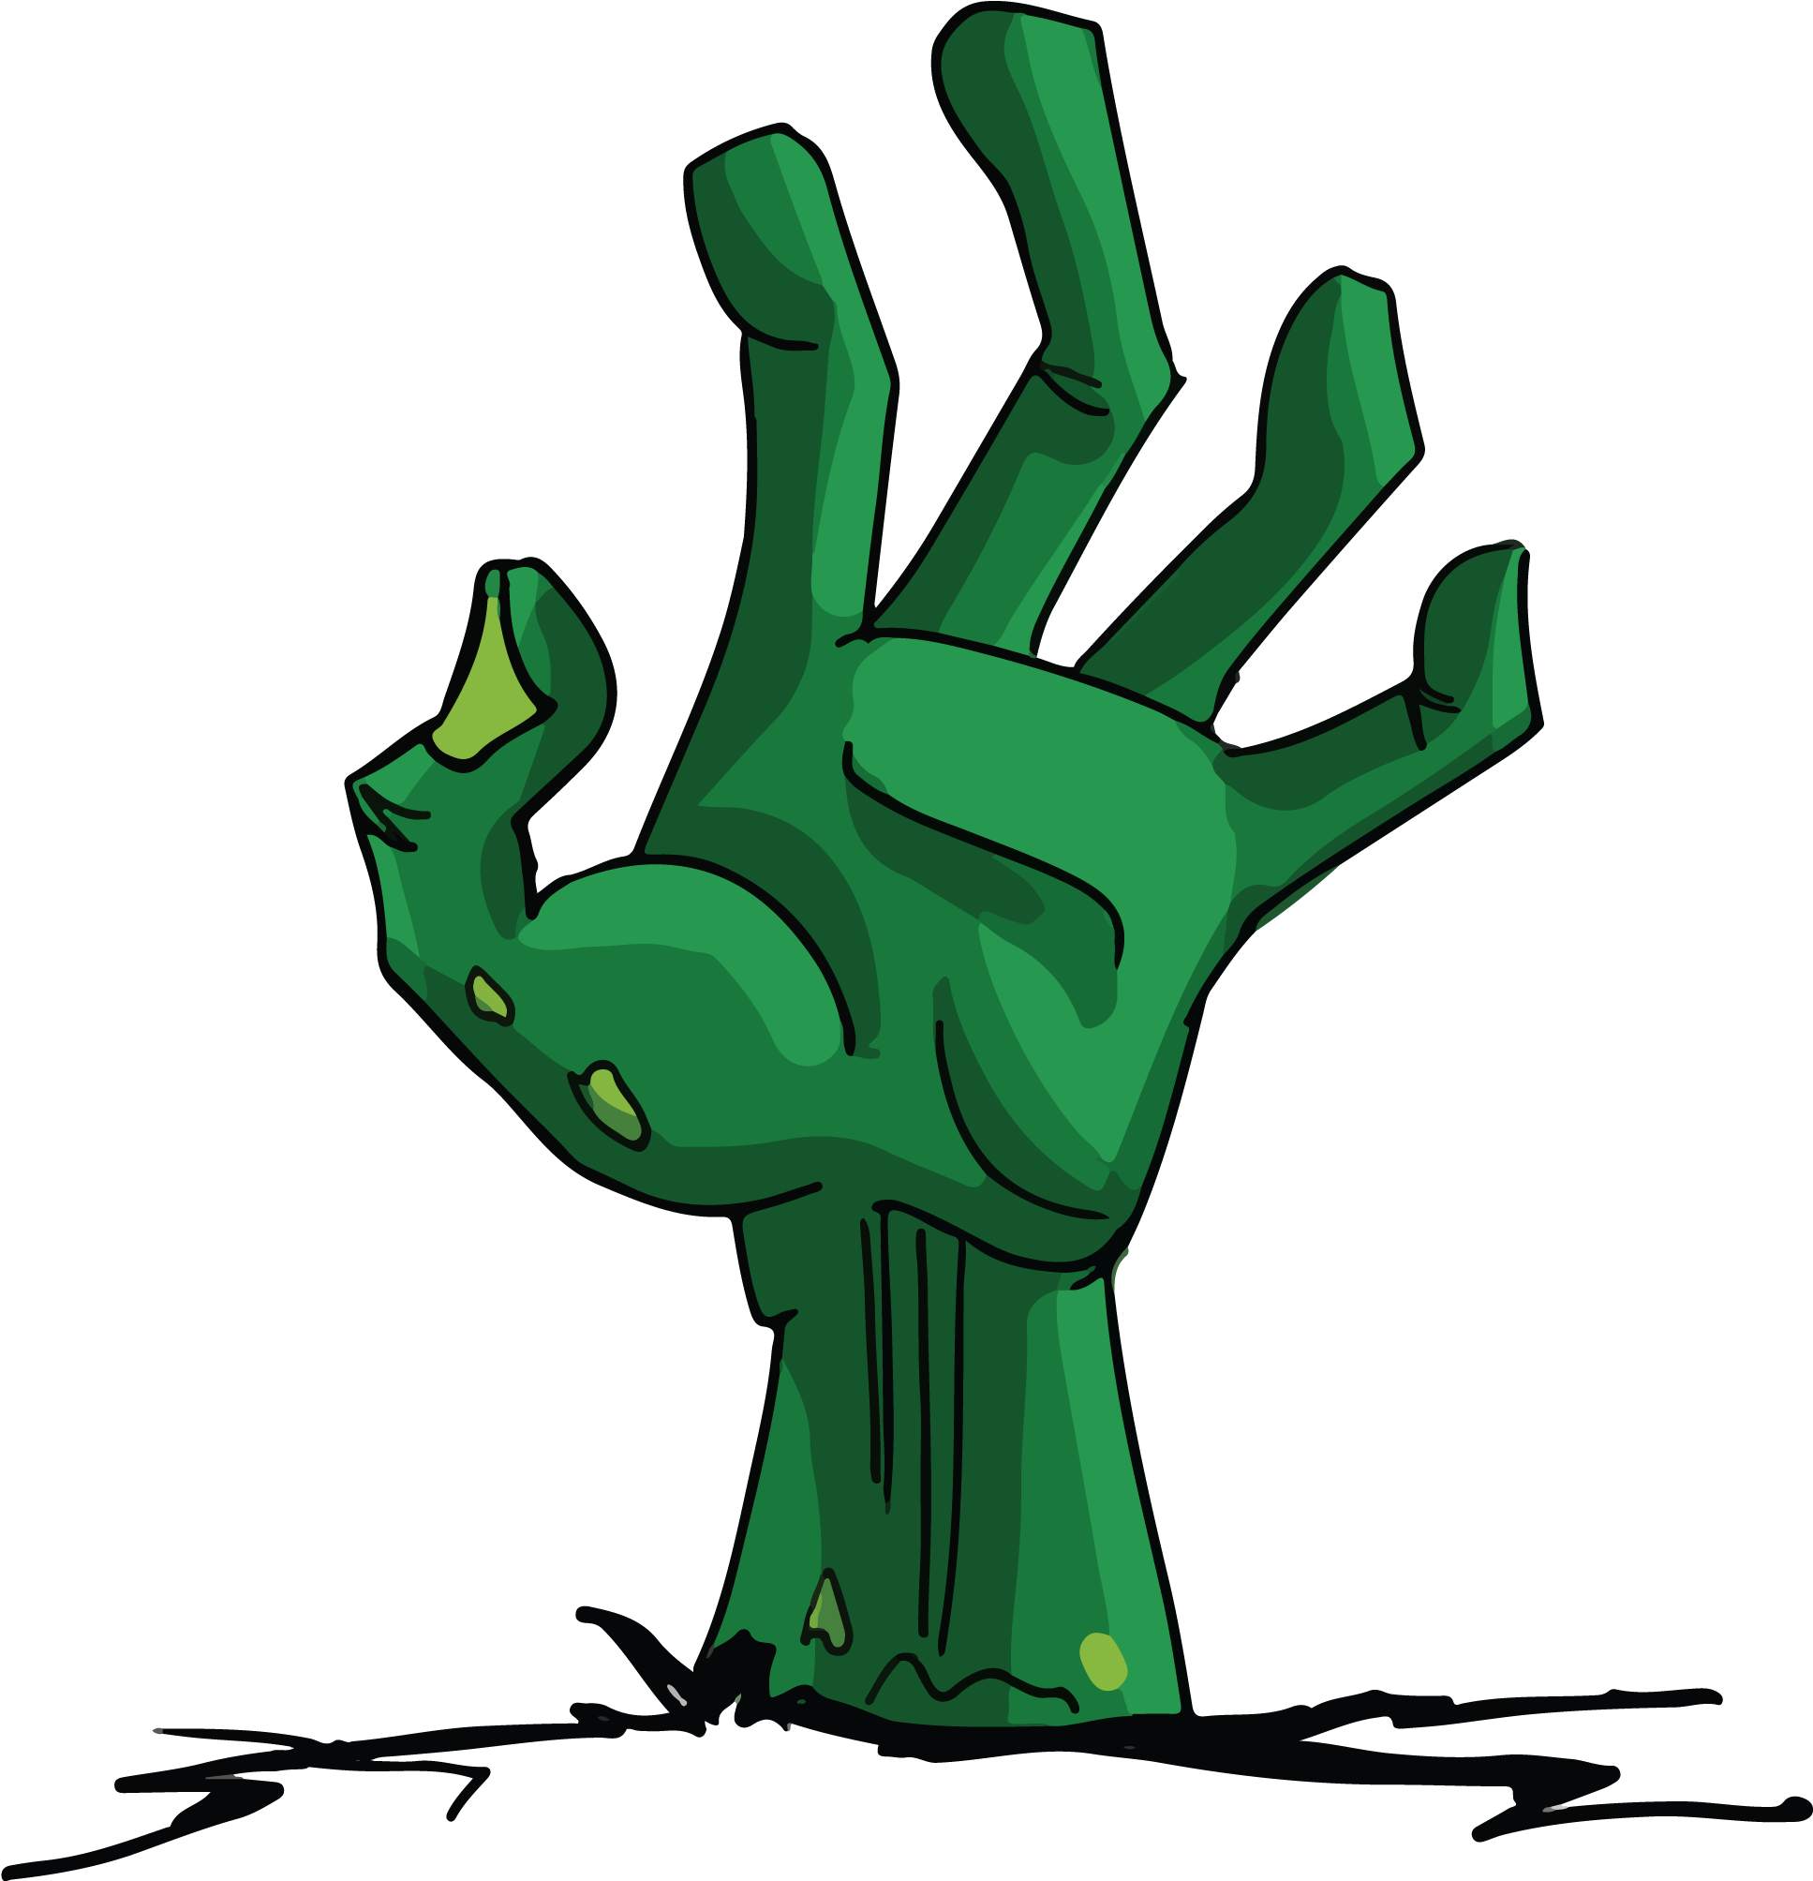
Necro Nursery
Team Abra-cadaver

Slide 2
Narrative
Started fleshing out history in many areas of our world bible
Necromancy in general
Player characters and their superiors
Monsters
Explained minigames
Backstories
Relevance to Necromancy
Minigames link to resources

Slide 3
Audio
Added Summoning Minigame song
Randomized velocities
Made music much less repetitive
Created sound effects for Summoning minigame

Slide 4
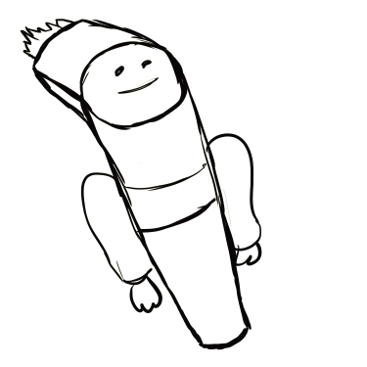
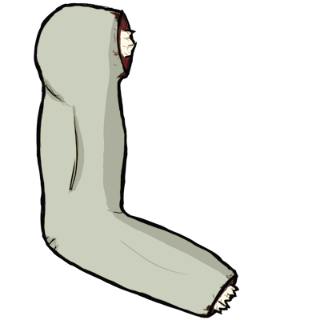
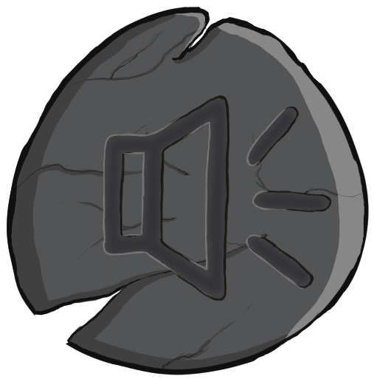

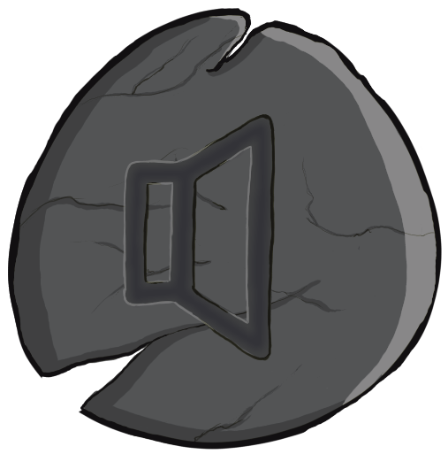


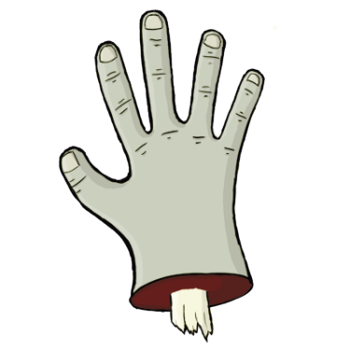
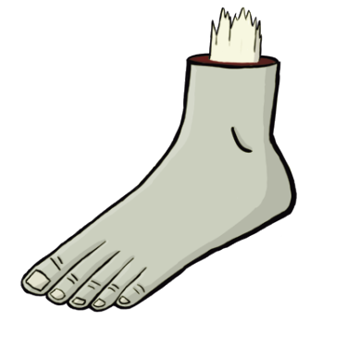



Slide 5
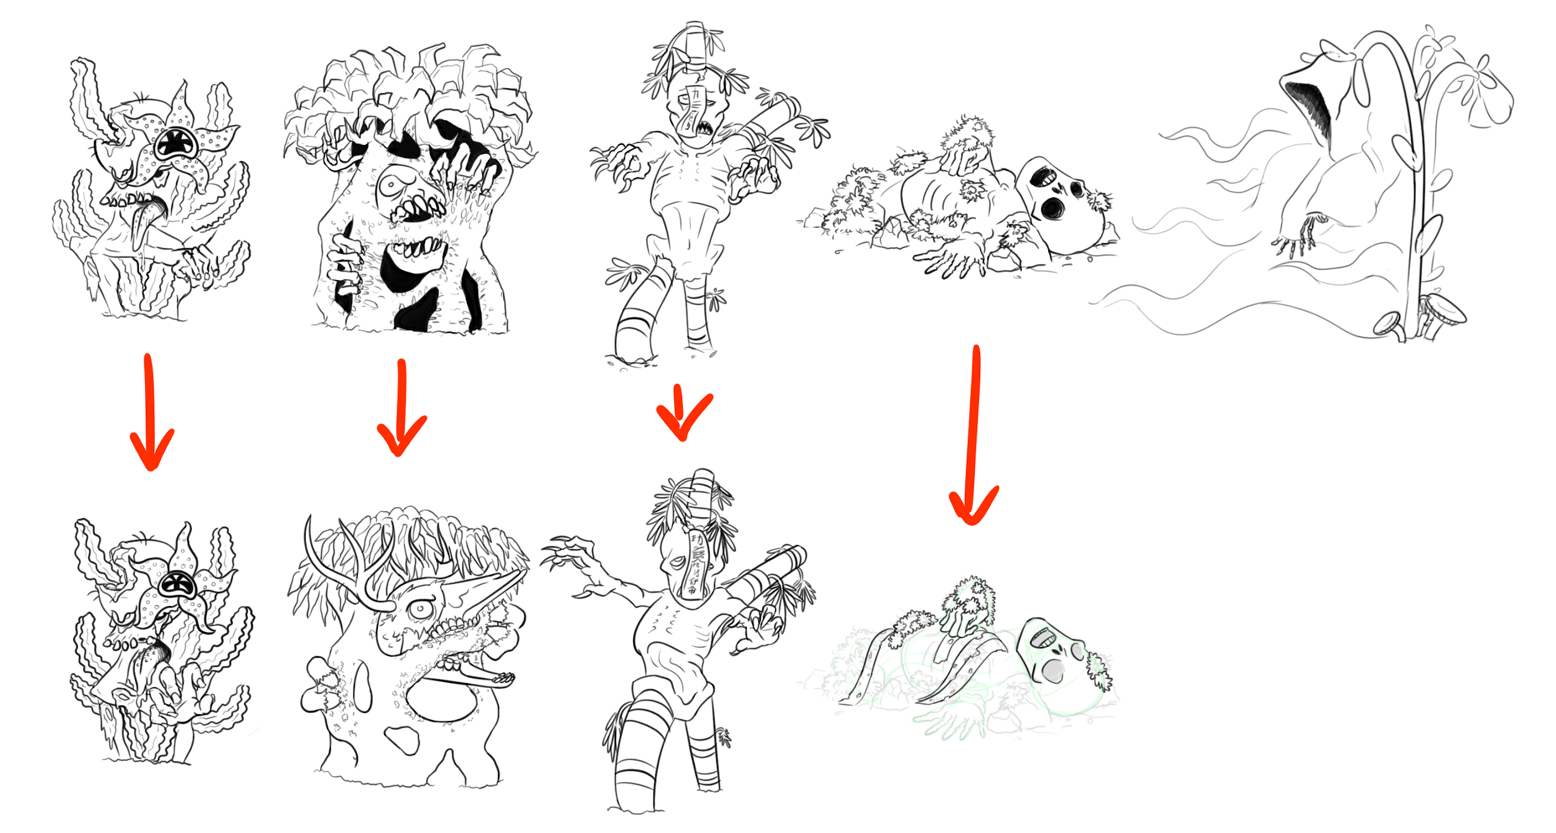
Finalizing
Concepts
^ Ready to be made into assets ^

Slide 6
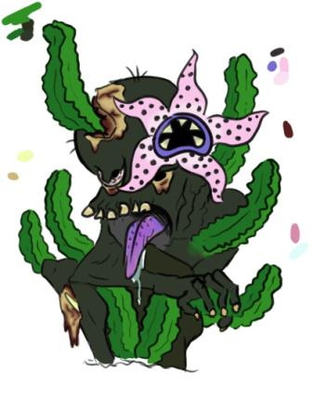
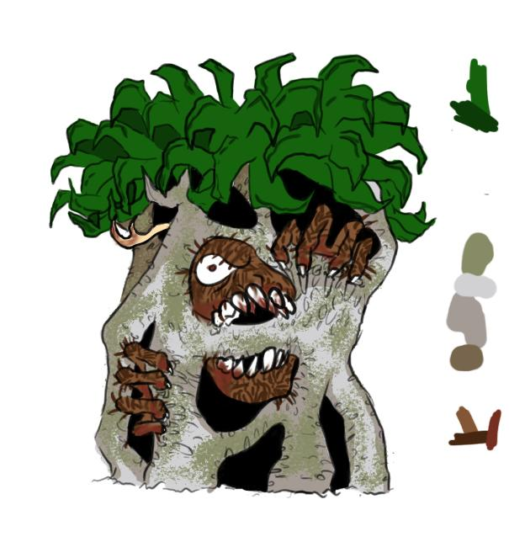

Slide 7
Programming
Saving and loading completed … For now
Positioning GameObjects based on screen size
Rune Minigame
Swipe to draw
Morgue done? (playtesting for bugs)

Slide 8
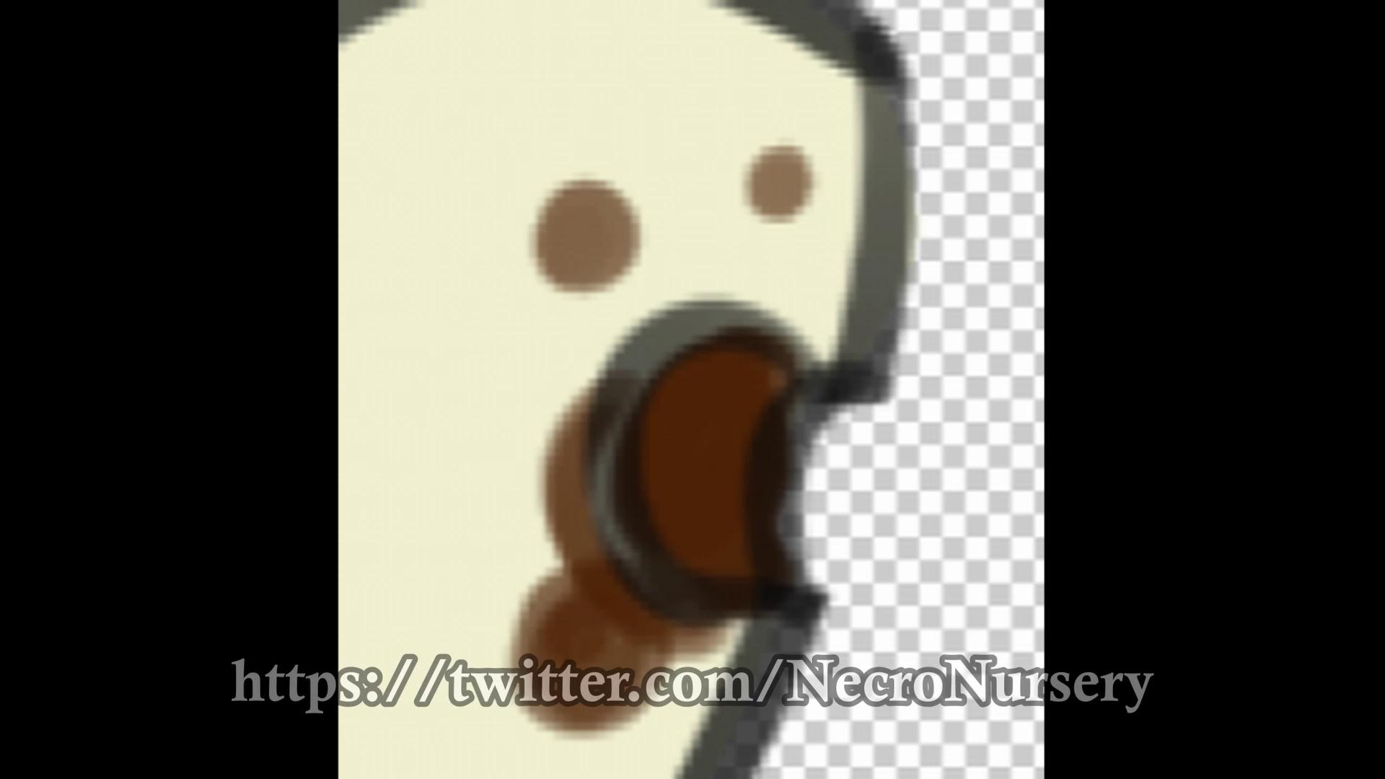
Trailer thing i guess

Slide 9
Troubles along the way?
Filling new team member in
Creating music without visuals completed
App not working on some phones

Slide 10
What we plan to do!
Make sure Carl has a warm welcome to his new superior team
Create trailer music or decide on which current song to use

Slide 11
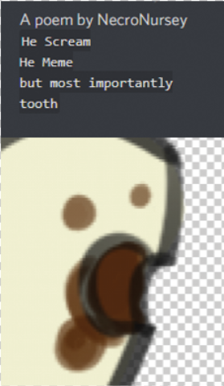
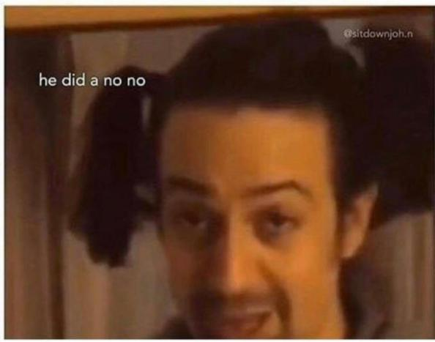
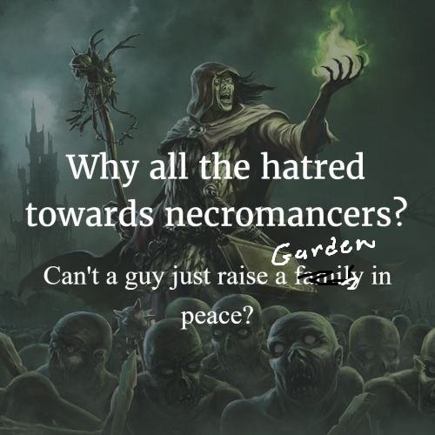

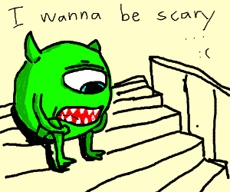
Questions?

